Slide 1
Just Enough Spectral Theory
Ng Yen Kaow

Slide 2
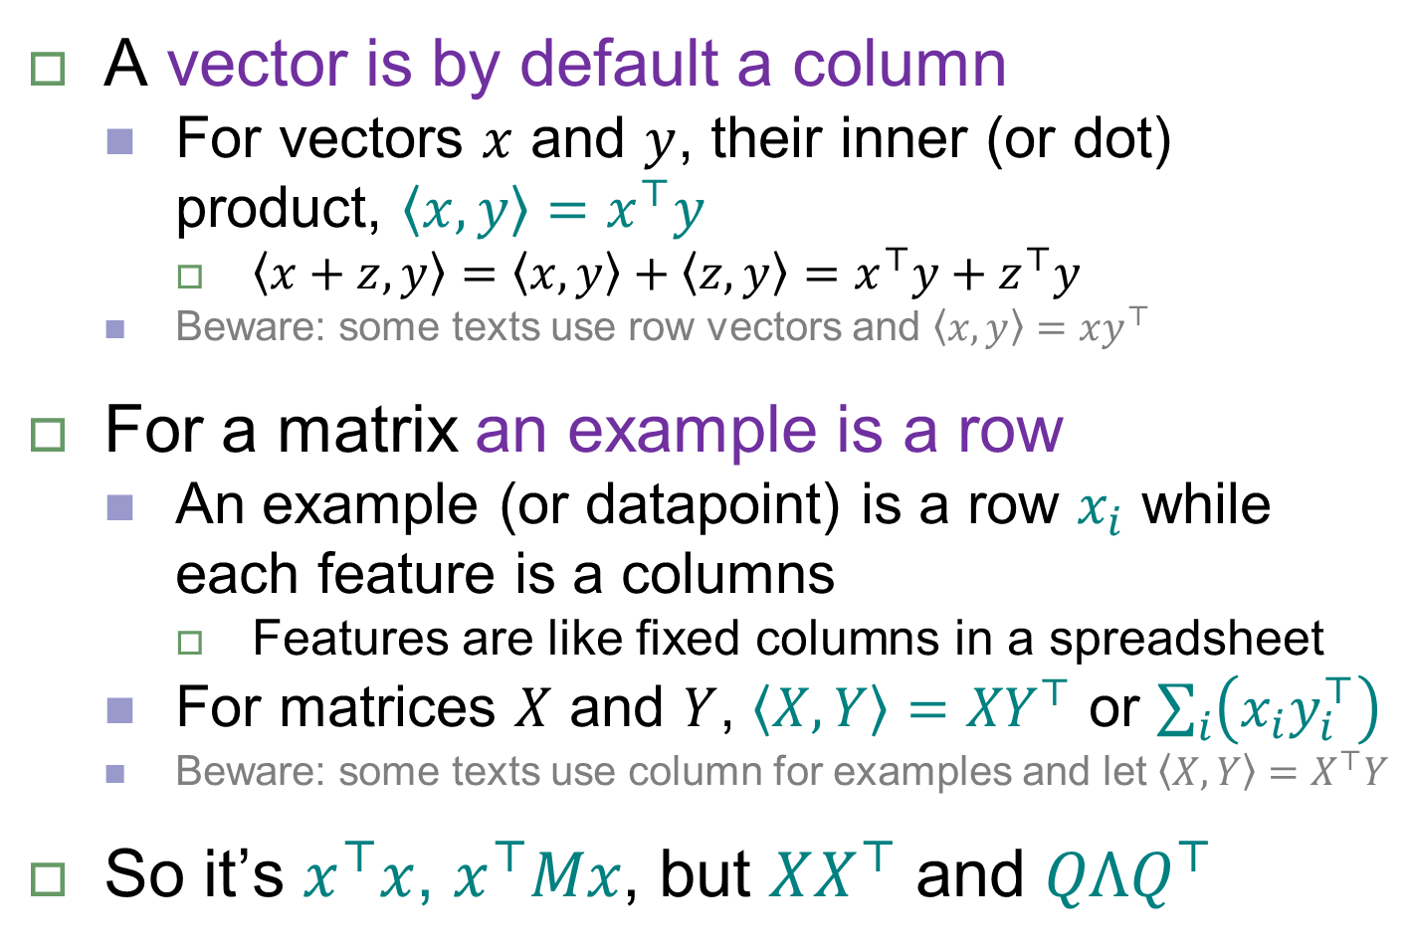
Notations (Important)
A vector is by default a column
For vectors $x$ and $y$, their inner (or dot) product, $\left\langle x,y\right\rangle =x^{⊤}y$
$\left\langle x+z,y\right\rangle =\left\langle x,y\right\rangle +\left\langle z,y\right\rangle =x^{⊤}y+z^{⊤}y$
Beware: some texts use row vectors and $\left\langle x,y\right\rangle =xy^{⊤}$
For a matrix an example is a row
An example (or datapoint) is a row $x_{i}$ while each feature is a columns
Features are like fixed columns in a spreadsheet
For matrices $X$ and $Y$, $\left\langle X,Y\right\rangle ={XY}^{⊤}$ or $\sum_{i}{\left(x_{i}y_{i}^{⊤}\right)}$
Beware: some texts use column for examples and let $\left\langle X,Y\right\rangle =X^{⊤}Y$
So it’s $x^{⊤}x$, $x^{⊤}Mx$, but $XX^{⊤}$ and $QΛQ^{⊤}$

Slide 3
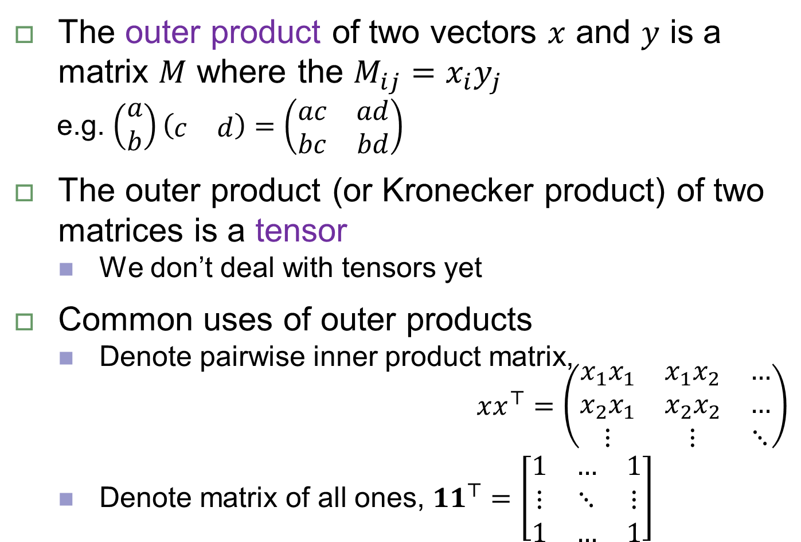
Outer product
The outer product of two vectors $x$ and $y$ is a matrix $M$ where the $M_{ij}=x_{i}y_{j}$
e.g. $\left(\begin{matrix}a \\ b\end{matrix}\right)\left(\begin{matrix}c & d\end{matrix}\right)=\left(\begin{matrix}ac & ad \\ bc & bd\end{matrix}\right)$
The outer product (or Kronecker product) of two matrices is a tensor
We don’t deal with tensors yet
Common uses of outer products
Denote pairwise inner product matrix,
$xx^{⊤}=\left(\begin{matrix}x_{1}x_{1} & x_{1}x_{2} & … \\ x_{2}x_{1} & x_{2}x_{2} & … \\ ⋮ & ⋮ & ⋱\end{matrix}\right)$
Denote matrix of all ones, ${11}^{⊤}=\left[\begin{matrix}1 & … & 1 \\ ⋮ & ⋱ & ⋮ \\ 1 & … & 1\end{matrix}\right]$

Slide 4
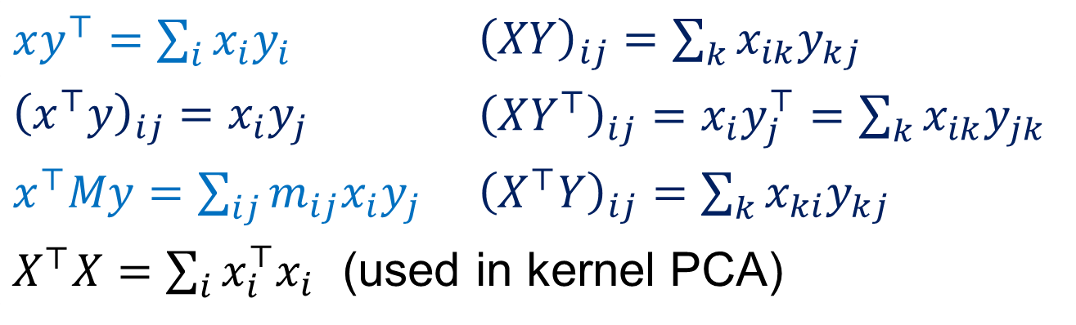

More notations
Conventions
$x_{i}$ from a matrix is by default a row vector
$x_{i}$ from a vector is a scalar
$x_{ij}$ from a matrix is a scalar
$x$, $u_{i}$ (all other vectors) are by default column vectors
Common expansions
$xy^{⊤}=\sum_{i}{x_{i}y_{i}}$ | ${\left(XY\right)}_{ij}=\sum_{k}{x_{ik}y_{kj}}$
${\left(x^{⊤}y\right)}_{ij}=x_{i}y_{j}$ | ${\left(XY^{⊤}\right)}_{ij}=x_{i}y_{j}^{⊤}=\sum_{k}{x_{ik}y_{jk}}$
$x^{⊤}My=\sum_{ij}{m_{ij}x_{i}y_{j}}$ | ${\left(X^{⊤}Y\right)}_{ij}=\sum_{k}{x_{ki}y_{kj}}$
$X^{⊤}X=\sum_{i}{x_{i}^{⊤}x_{i}}$ (used in kernel PCA)

Slide 5
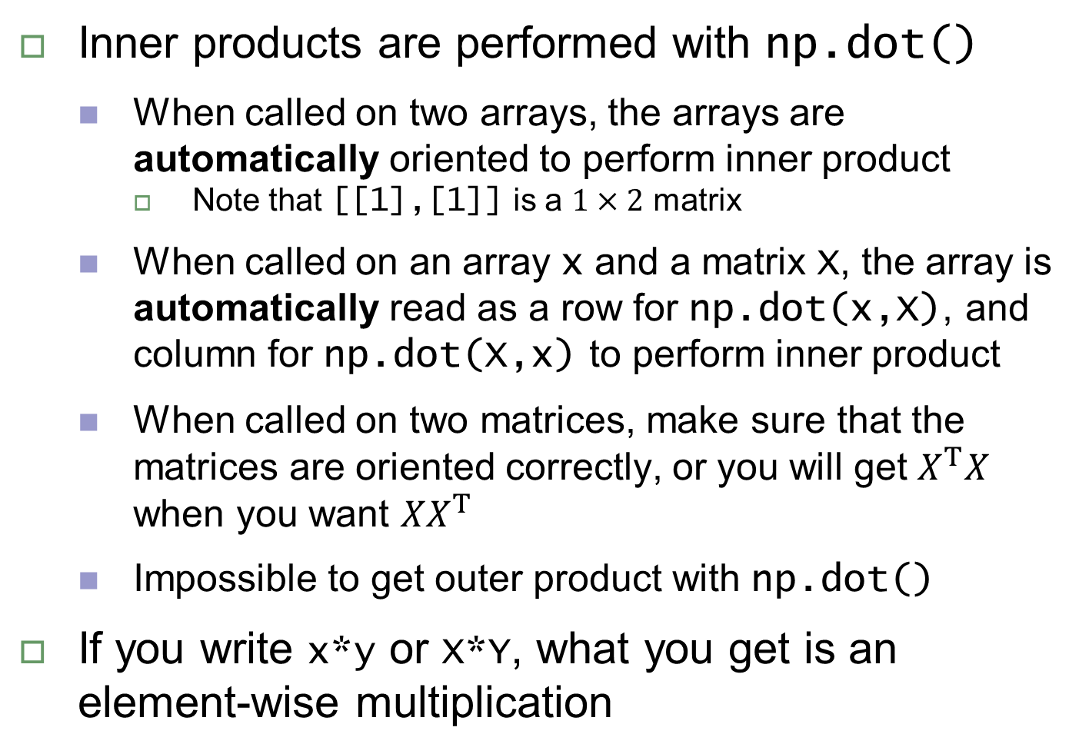
Python call for inner product
Inner products are performed with np.dot()
When called on two arrays, the arrays are automatically oriented to perform inner product
Note that [[1],[1]] is a $1×2$ matrix
When called on an array x and a matrix X, the array is automatically read as a row for np.dot(x,X), and column for np.dot(X,x) to perform inner product
When called on two matrices, make sure that the matrices are oriented correctly, or you will get $X^{T}X$ when you want $XX^{T}$
Impossible to get outer product with np.dot()
If you write x*y or X*Y, what you get is an element-wise multiplication

Slide 6
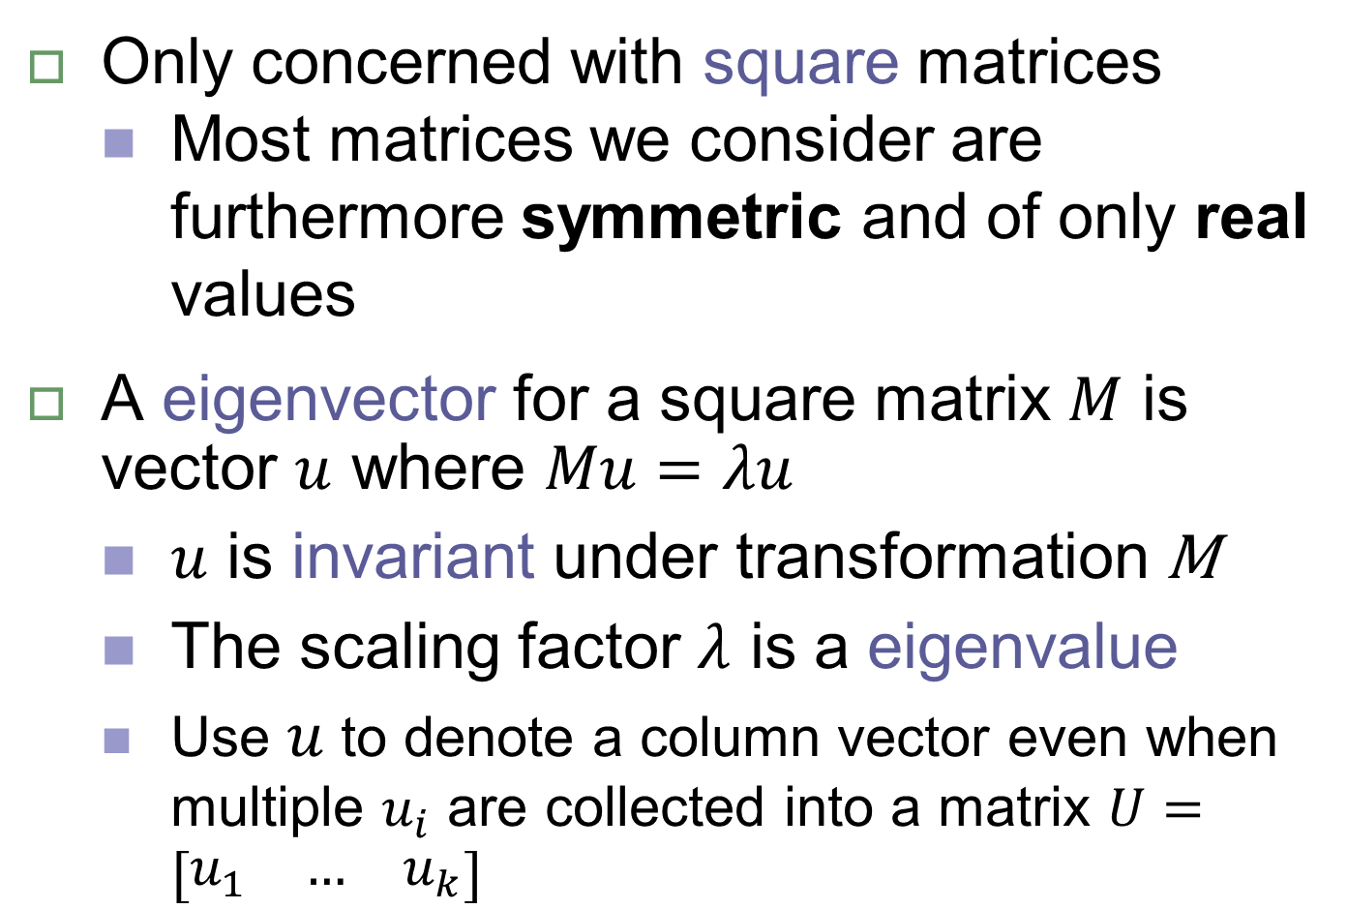
Eigenvectors and eigenvalues
Only concerned with square matrices
Most matrices we consider are furthermore symmetric and of only real values
A eigenvector for a square matrix $M$ is vector $u$ where $Mu=λu$
$u$ is invariant under transformation M
The scaling factor $λ$ is a eigenvalue
Use $u$ to denote a column vector even when multiple $u_{i}$ are collected into a matrix $U=\left[\begin{matrix}u_{1} & … & u_{k}\end{matrix}\right]$

Slide 7
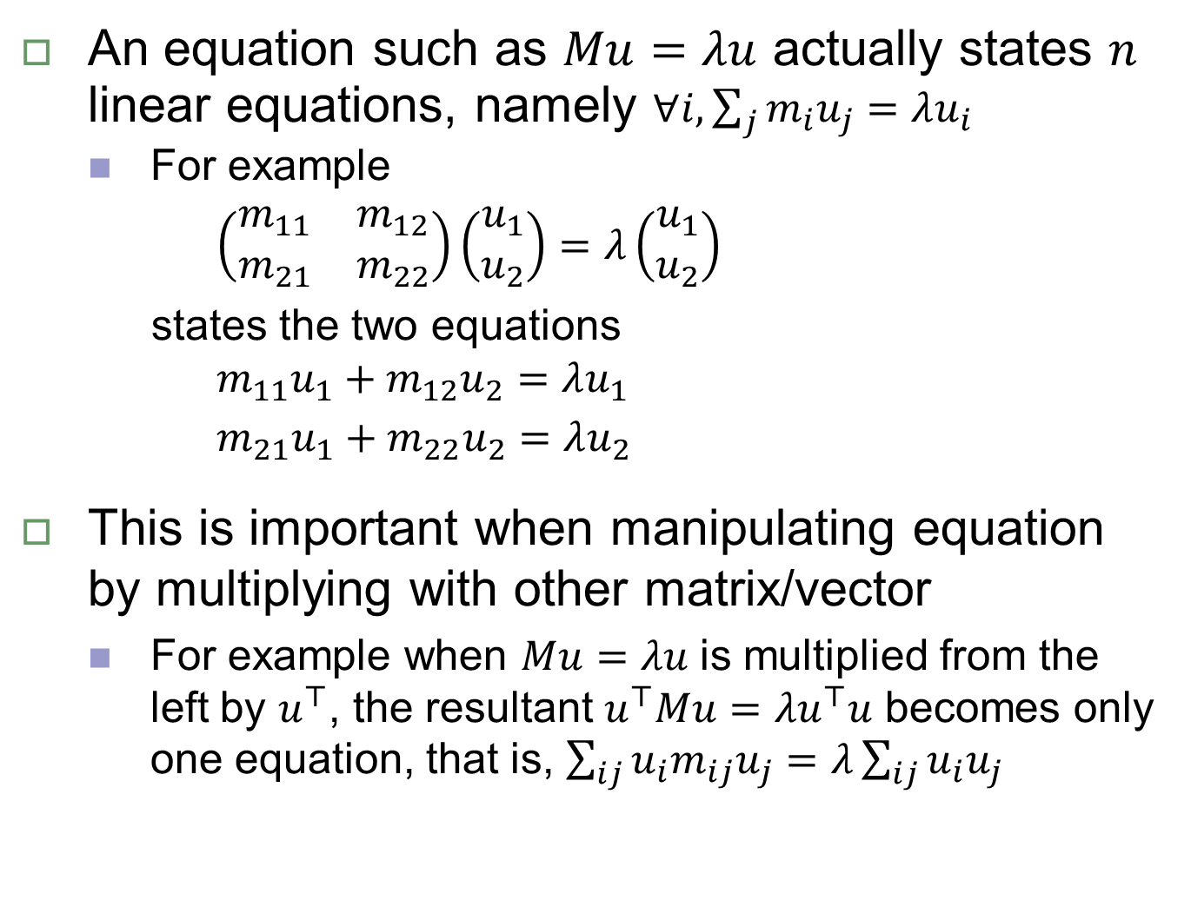
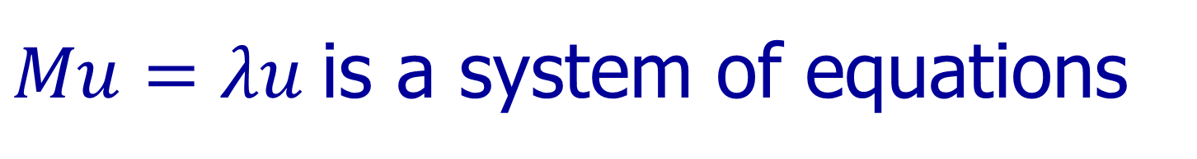
$Mu=λu$ is a system of equations
An equation such as $Mu=λu$ actually states $n$ linear equations, namely $∀i,\sum_{j}{m_{i}u_{j}}=λu_{i}$
For example
$\left(\begin{matrix}m_{11} & m_{12} \\ m_{21} & m_{22}\end{matrix}\right)\left(\begin{matrix}u_{1} \\ u_{2}\end{matrix}\right)=λ\left(\begin{matrix}u_{1} \\ u_{2}\end{matrix}\right)$
states the two equations
$m_{11}u_{1}+m_{12}u_{2}=λu_{1}$
$m_{21}u_{1}+m_{22}u_{2}=λu_{2}$
This is important when manipulating equation by multiplying with other matrix/vector
For example when $Mu=λu$ is multiplied from the left by $u^{⊤}$, the resultant $u^{⊤}Mu=λu^{⊤}u$ becomes only one equation, that is, $\sum_{ij}{u_{i}m_{ij}u_{j}}=λ\sum_{ij}{u_{i}u_{j}}$

Slide 8
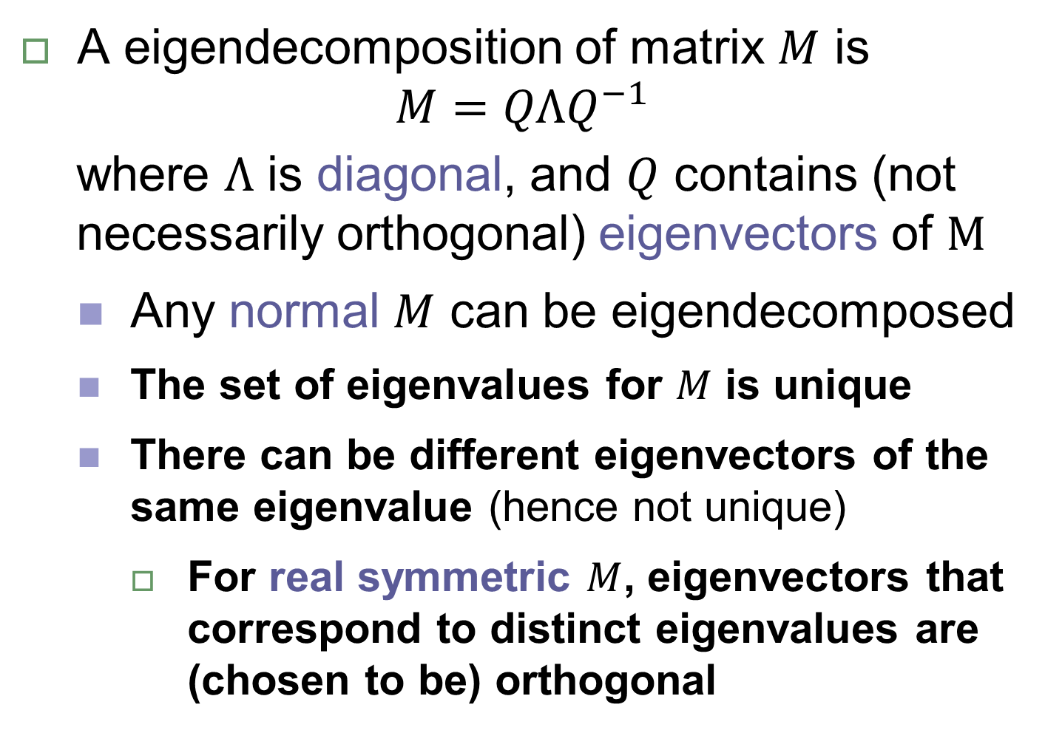
Eigendecomposition
A eigendecomposition of matrix $M$ is
$$M=QΛQ^{−1}$$
where $Λ$ is diagonal, and $Q$ contains (not necessarily orthogonal) eigenvectors of $M$
Any normal $M$ can be eigendecomposed
The set of eigenvalues for $M$ is unique
There can be different eigenvectors of the same eigenvalue (hence not unique)
For real symmetric $M$, eigenvectors that correspond to distinct eigenvalues are (chosen to be) orthogonal

Slide 9
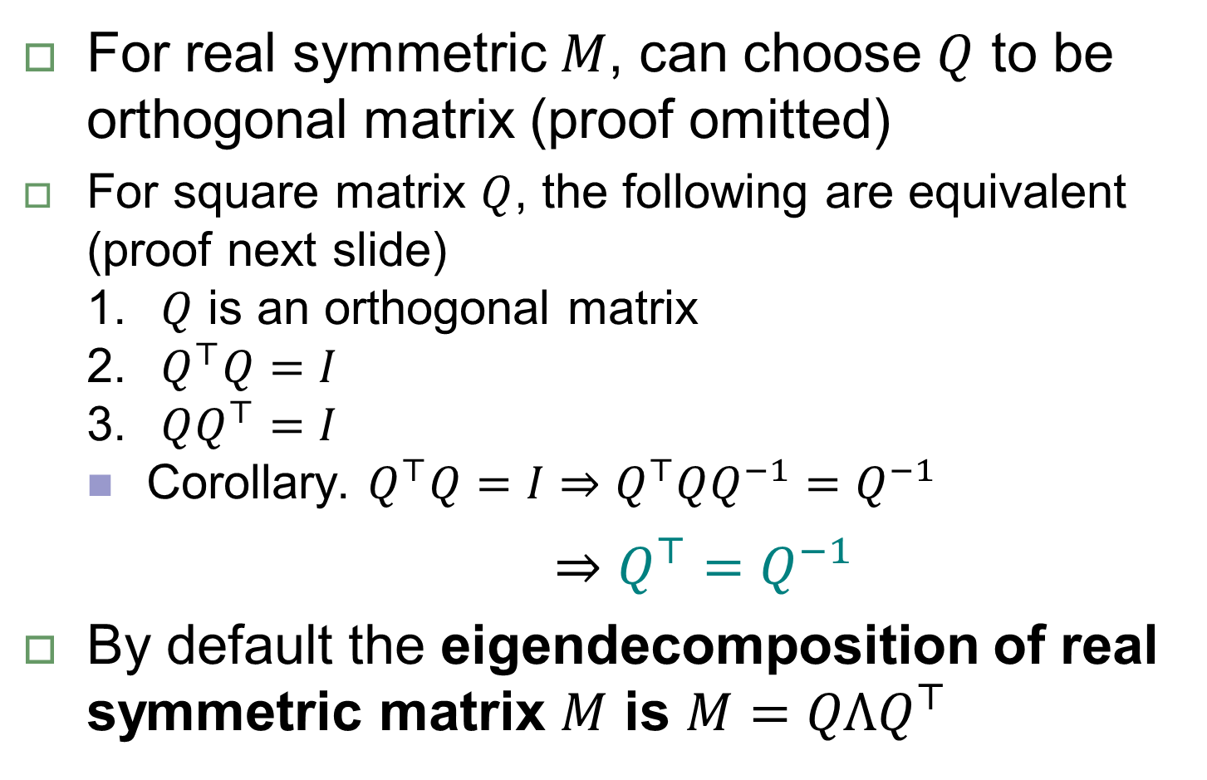
Orthogonal eigendecomposition
For real symmetric $M$, can choose $Q$ to be orthogonal matrix (proof omitted)
For square matrix $Q$, the following are equivalent (proof next slide)
$Q$ is an orthogonal matrix
$Q^{⊤}Q=I$
$QQ^{⊤}=I$
Corollary. $Q^{⊤}Q=I⇒Q^{⊤}QQ^{−1}=Q^{−1}$
$⇒Q^{⊤}=Q^{−1}$
By default the eigendecomposition of real symmetric matrix $M$ is $M=QΛQ^{⊤}$

Slide 10
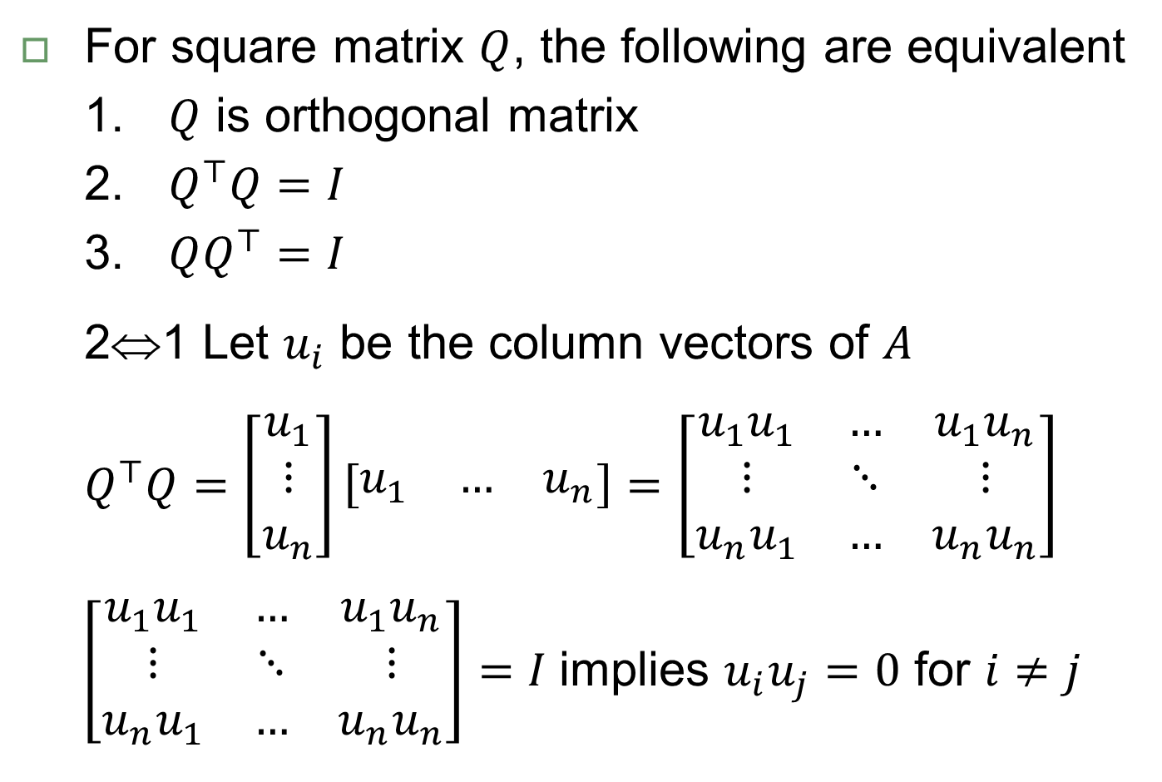
Orthogonal matrix property
For square matrix $Q$, the following are equivalent
$Q$ is orthogonal matrix
$Q^{⊤}Q=I$
$QQ^{⊤}=I$
2⇔1 Let $u_{i}$ be the column vectors of $A$
$$Q^{⊤}Q=\left[\begin{matrix}u_{1} \\ ⋮ \\ u_{n}\end{matrix}\right]\left[\begin{matrix}u_{1} & … & u_{n}\end{matrix}\right]=\left[\begin{matrix}u_{1}u_{1} & … & u_{1}u_{n} \\ ⋮ & ⋱ & ⋮ \\ u_{n}u_{1} & … & u_{n}u_{n}\end{matrix}\right]$$
$\left[\begin{matrix}u_{1}u_{1} & … & u_{1}u_{n} \\ ⋮ & ⋱ & ⋮ \\ u_{n}u_{1} & … & u_{n}u_{n}\end{matrix}\right]=I$ implies $u_{i}u_{j}=0$ for $i≠j$

Slide 11
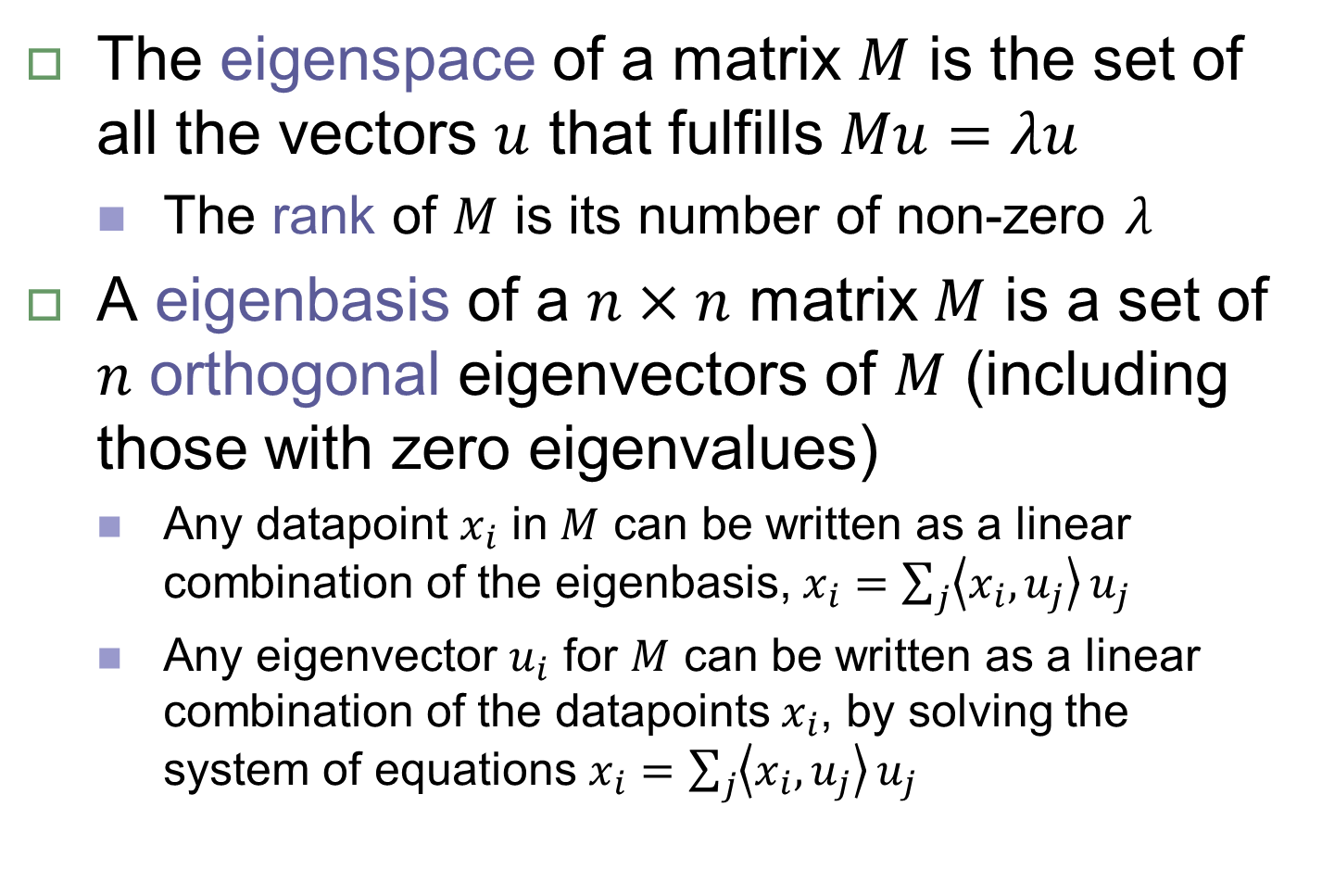
Eigenspace
The eigenspace of a matrix $M$ is the set of all the vectors $u$ that fulfills $Mu=λu$
The rank of $M$ is its number of non-zero $λ$
A eigenbasis of a $n×n$ matrix $M$ is a set of $n$ orthogonal eigenvectors of $M$ (including those with zero eigenvalues)
Any datapoint $x_{i}$ in $M$ can be written as a linear combination of the eigenbasis, $x_{i}=\sum_{j}{\left\langle x_{i},u_{j}\right\rangle }u_{j}$
Any eigenvector $u_{i}$ for $M$ can be written as a linear combination of the datapoints $x_{i}$, by solving the system of equations $x_{i}=\sum_{j}{\left\langle x_{i},u_{j}\right\rangle }u_{j}$

Slide 12
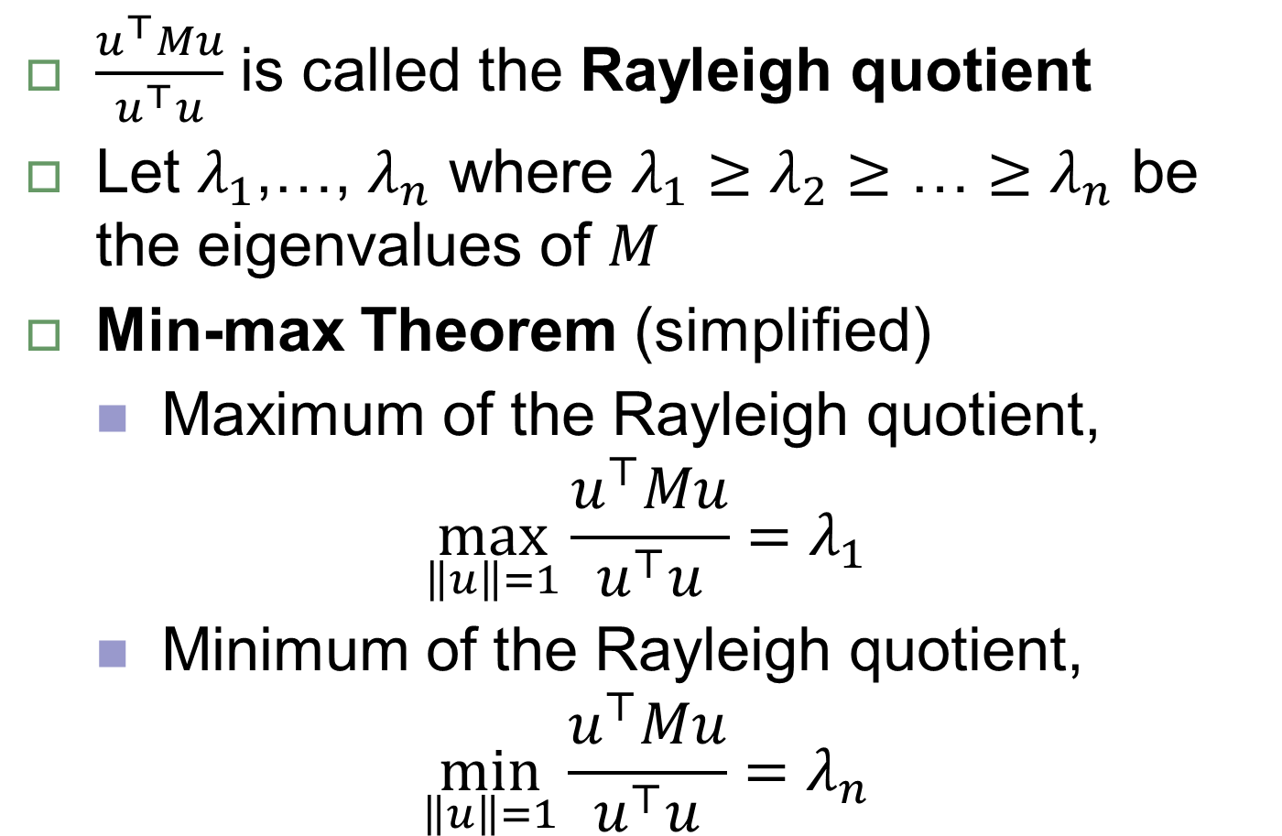
Rayleigh Quotient
$\frac{u^{⊤}Mu}{u^{⊤}u}$ is called the Rayleigh quotient
Let $λ_{1}$,…, $λ_{n}$ where ${λ_{1}≥λ_{2}≥\text{…}≥λ}_{n}$ be the eigenvalues of $M$
Min-max Theorem (simplified)
Maximum of the Rayleigh quotient,
$$\max_{\left\|u\right\|=1}{\frac{u^{⊤}Mu}{u^{⊤}u}}=λ_{1}$$
Minimum of the Rayleigh quotient,
$$\min_{\left\|u\right\|=1}{\frac{u^{⊤}Mu}{u^{⊤}u}}=λ_{n}$$

Slide 13

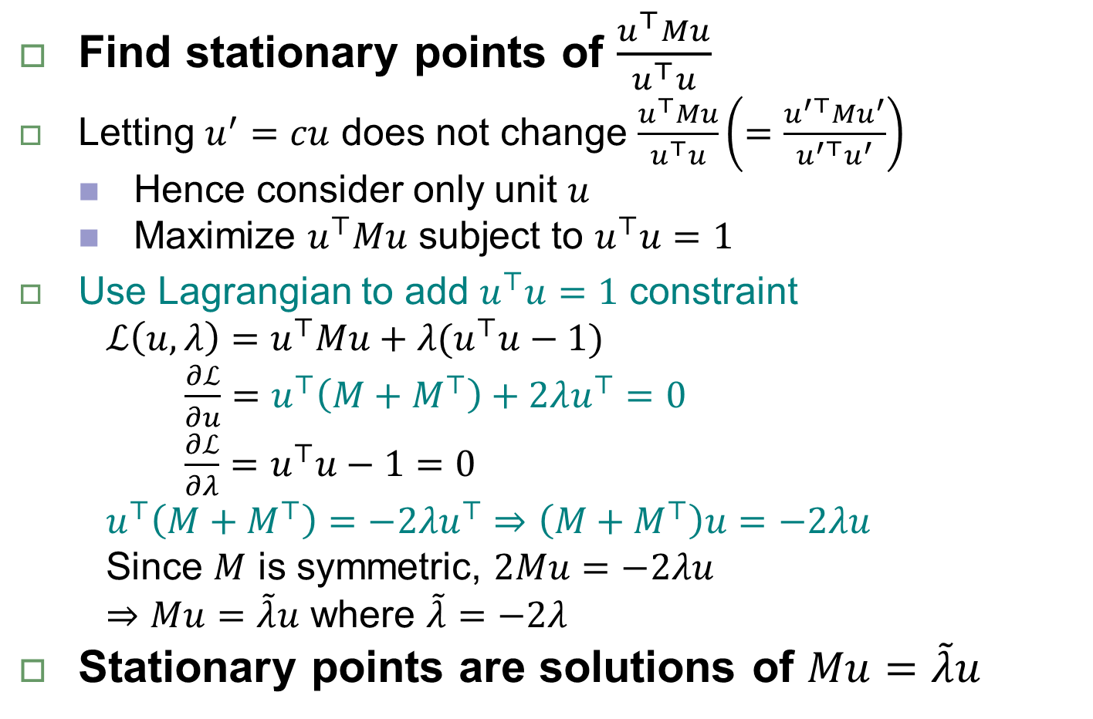
Proof of min-max theorem
Find stationary points of $\frac{u^{⊤}Mu}{u^{⊤}u}$
Letting $u^{′}=cu$ does not change $\frac{u^{⊤}Mu}{u^{⊤}u}\left(=\frac{u^{′⊤}Mu^{′}}{u^{′⊤}u^{′}}\right)$
Hence consider only unit $u$
Maximize $u^{⊤}Mu$ subject to $u^{⊤}u=1$
Use Lagrangian to add $u^{⊤}u=1$ constraint
$ℒ\left(u,λ\right)=u^{⊤}Mu+λ(u^{⊤}u−1)$
$\frac{∂ℒ}{∂u}=u^{⊤}\left(M+M^{⊤}\right)+2λu^{⊤}=0$
$\frac{∂ℒ}{∂λ}=u^{⊤}u−1=0$
$u^{⊤}\left(M+M^{⊤}\right)=−2λu^{⊤}⇒\left(M+M^{⊤}\right)u=−2λu$
Since $M$ is symmetric, $2Mu=−2λu$
$⇒Mu=\tilde{λ}u$ where $\tilde{λ}=−2λ$
Stationary points are solutions of $Mu=\tilde{λ}u$
Matrix differentiation*
$\frac{∂x^{⊤}Mx}{∂x}=x^{⊤}\left(M+M^{⊤}\right)$
$\frac{∂x^{⊤}x}{∂x}=2x^{⊤}$
* https://www.comp.nus.edu.sg/~CS5240/lecture/matrix-diff.pdf

Slide 14
Eigendecomposition applications
Matrix inverse
Matrix approximation
Matrix factorization
Multidimensional Scaling
Minimizing/maximizing Rayleigh Quotient
PCA
Max of covariance matrix
Spectral clustering
Min of graph Laplacian

Slide 15
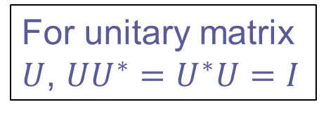
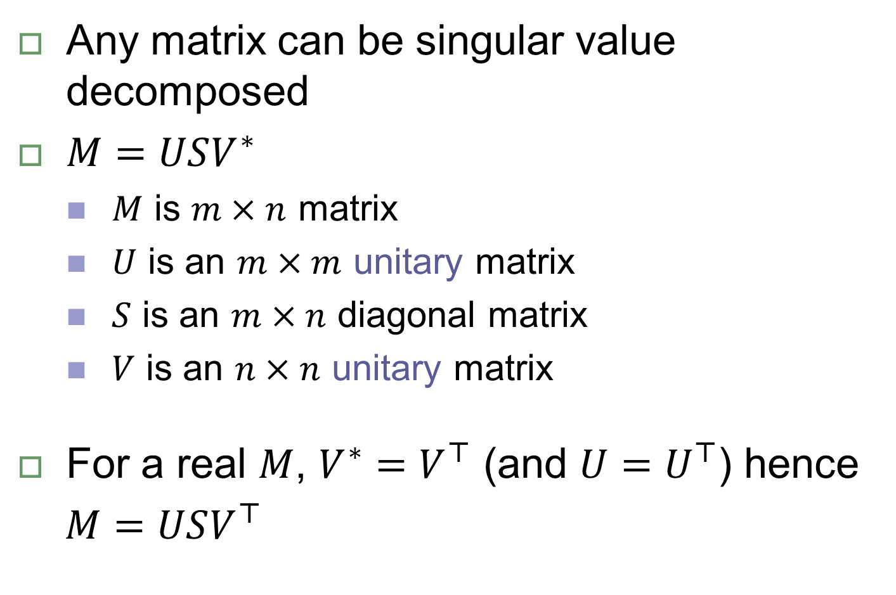
Singular Value Decomposition
Any matrix can be singular value decomposed
$M=USV^{∗}$
$M$ is $m×n$ matrix
$U$ is an $m×m$ unitary matrix
$S$ is an $m×n$ diagonal matrix
$V$ is an $n×n$ unitary matrix
For a real $M$, $V^{∗}=V^{⊤}$ (and $U=U^{⊤}$) hence
$M=USV^{⊤}$
For unitary matrix $U$, $UU^{∗}=U^{∗}U=I$

Slide 16
SVD applications
Solving linear equations
Linear regression
Pseudoinverse
Kabsch algorithm
Matrix approximation
As a eigendecomposition (see next slide)

Slide 17
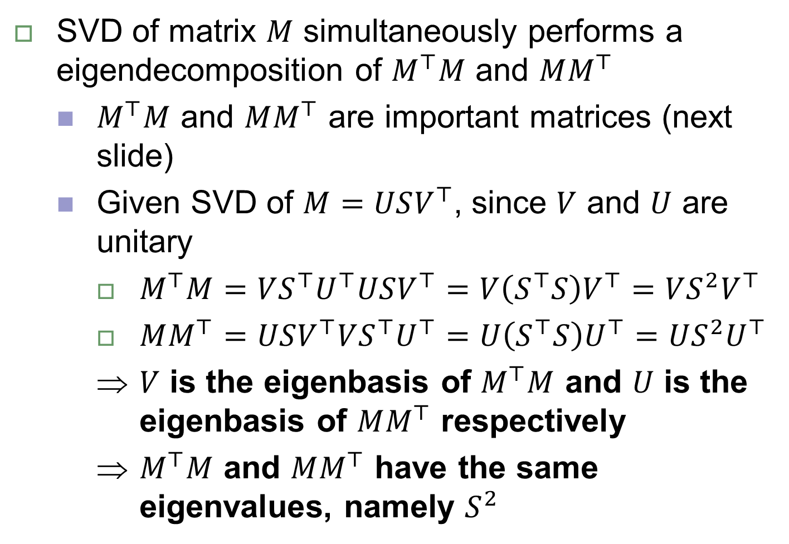
SVD and eigendecomposition
SVD of matrix $M$ simultaneously performs a eigendecomposition of $M^{⊤}M$ and $MM^{⊤}$
$M^{⊤}M$ and $MM^{⊤}$ are important matrices (next slide)
Given SVD of $M=USV^{⊤}$, since $V$ and $U$ are unitary
$M^{⊤}M=VS^{⊤}U^{⊤}USV^{⊤}=V{\left(S^{⊤}S\right)V}^{⊤}=VS^{2}V^{⊤}$
$MM^{⊤}=USV^{⊤}VS^{⊤}U^{⊤}=U{\left(S^{⊤}S\right)U}^{⊤}=US^{2}U^{⊤}$
$V$ is the eigenbasis of $M^{⊤}M$ and $U$ is the eigenbasis of $MM^{⊤}$ respectively
$M^{⊤}M$ and $MM^{⊤}$ have the same eigenvalues, namely $S^{2}$

Slide 18
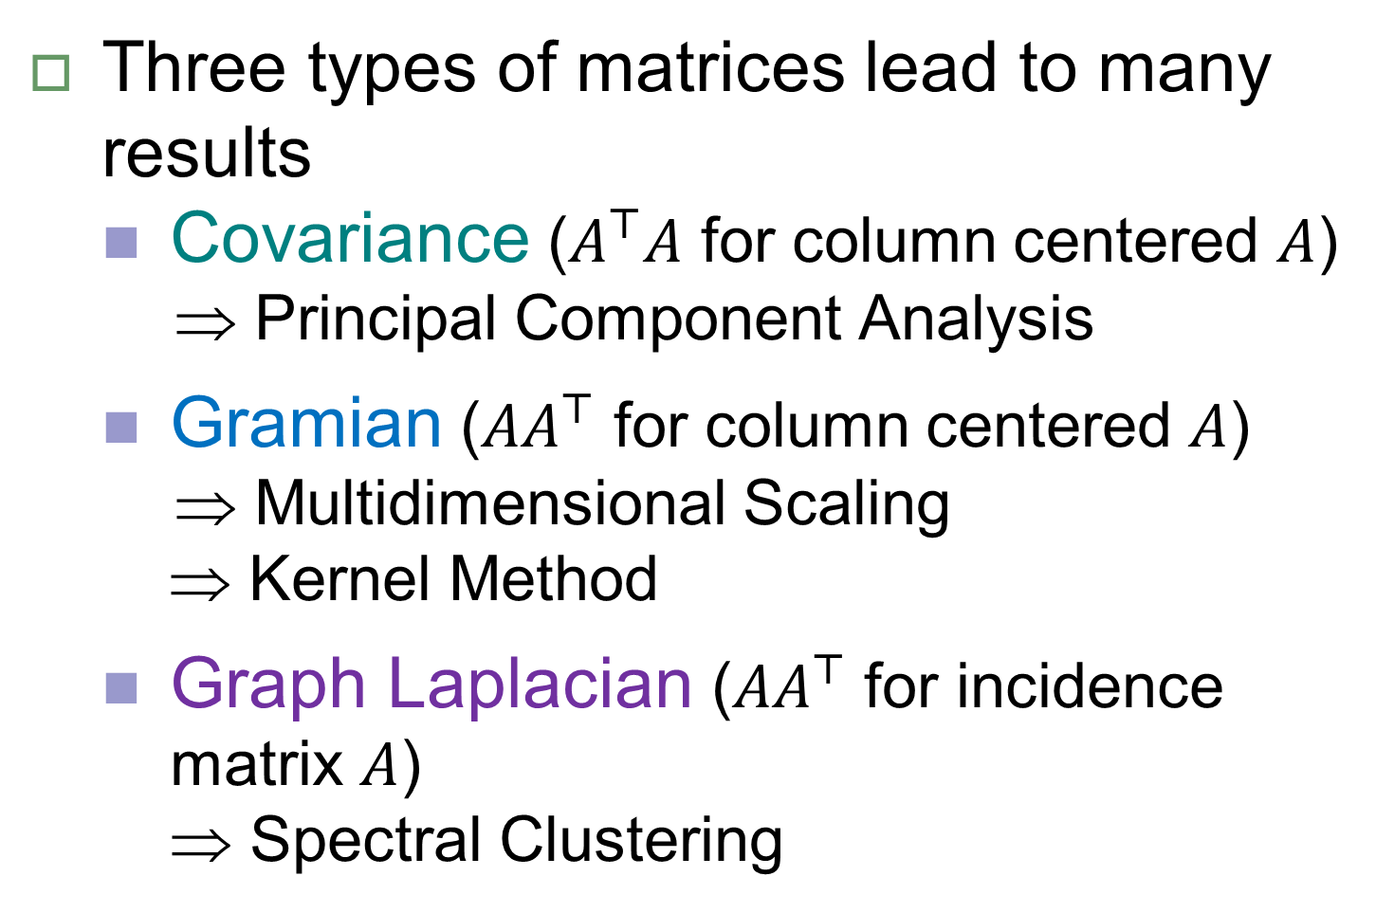
Special Matrices
Three types of matrices lead to many results
Covariance ($A^{⊤}A$ for column centered $A$)
⇒ Principal Component Analysis
Gramian (${AA}^{⊤}$ for column centered $A$)
⇒ Multidimensional Scaling
⇒ Kernel Method
Graph Laplacian (${AA}^{⊤}$ for incidence matrix $A$)
⇒ Spectral Clustering

